Slide 1
New Tecumseth Fire Rescue
Firefighter I / OFFC-2008 S27
Fire Department Communications

Slide 2
Learning Objective 1
Explain the procedures for receiving emergency and nonemergency external communications.

Slide 3
Learning Objective 2
Describe the information required to dispatch emergency services.

Slide 4
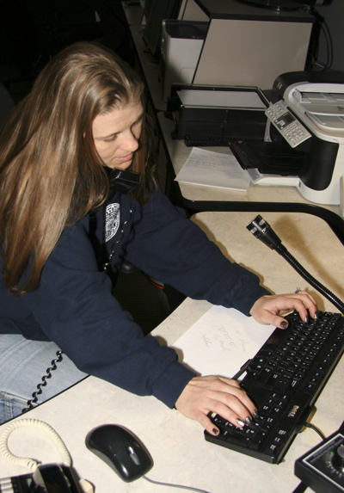
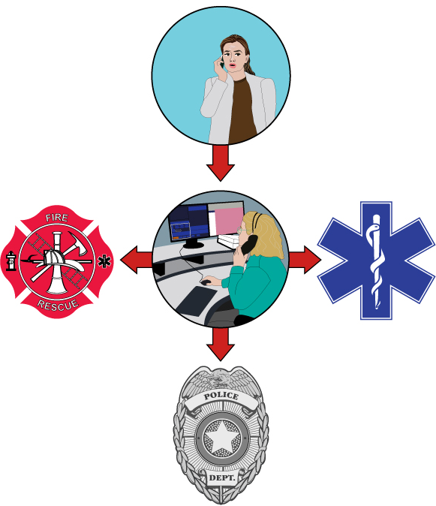
Emergency calls are received through two basic systems.
Barrie Fire Dispatch Center
Integrated 911 Service

Slide 5
Communications centers contain a variety of equipment.
Two-way radio
TDD-TTY-Text phone
Tone-generating equipment
Telephones
Direct-line telephones
Computers
Recording systems, devices
Alarm-receiving equipment

Slide 6
Processing an emergency call requires gathering information.
Type of emergency
Location of emergency
Number, location of people involved
Name, location of caller
Callback number
Cross street, landmarks nearby

Slide 7
Emergency calls are reported to responders in a variety of ways.
Enhanced 9-1-1
Public Alerting Systems
Radio
Wired telegraph circuit box - OBSOLETE
Radio fire alarm box - OBSOLETE
Telephone fire alarm box - OBSOLETE

Slide 8
REVIEW QUESTION
What is the procedure for receiving an emergency external communication?

Slide 9
Receiving nonemergency calls is also a part of station life.
All types
Requests for assistance (ie: Still Alarms/Station Walk-in Reports)
Personal calls
Know procedures
Be professional
Refer those you cannot answer to Joint Operations Center 905-729-1270 Ext 1425

Slide 10
You must remain calm and courteous when handling angry calls.
Take information
Refer caller
Joint Operations Center as contact
Be familiar with department

Slide 11
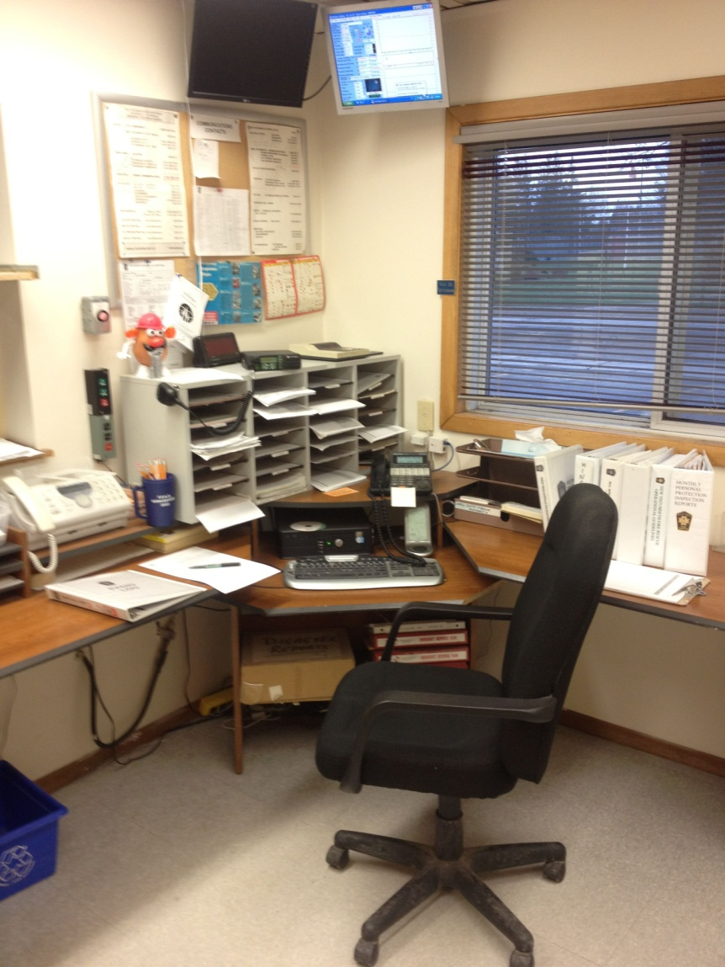
Manning the Radio Room at the Station
During a call, a firefighter or officer who has not been able to make a truck and is left at the station should ensure the radio room is manned during the call in case the station is called by Command for additional equipment or manpower.
During this time, the radio operator should document the call(s) and maintain a written log of activity. Calls should also be documented on a call log sheet.
Repeater Failure (Loss of Barrie Fire Control)
On occasion through technical failure or weather, a repeater may fail and Barrie Fire Control may not be able to reach us. A station may have to be manned in order to provide dispatch and local radio relay.
Should this occur, the Radio ID (ie: Tottenham, "Station XJH26") and the manning of the radio should be broadcast prior to assuming dispatch duties.
Example: "This is Station XJH26 Tottenham, all stations be advised Station XJH26 will be known as dispatch until further notice, time 15:00“
Once Barrie Fire Control has come back online, dispatch should be passed back to Barrie Fire Control and it would be announced on the radio.
Example: "This is Station XJH26 Tottenham, returning dispatch to Barrie Fire Control and signing off the air, time 16:00"

Slide 12
Emergency services dispatching begins with some form of alert.
Audible alarm
Pager
Alerting device

Slide 13
REVIEW QUESTION
What is the procedure for receiving a nonemergency external communication? (ie: Still Alarm)

Slide 14
Learning Objective 3
Describe the systems used for internal communications.

Slide 15
Internal communications are transmitted to specific groups.
Within fire department
Department to other agencies during emergencies

Slide 16
Radio systems used to transmit messages vary based on location and size.
Fixed location
Mobile
Portable
Courtesy of James Nilo

Slide 17
Radio signals transmit in either analog or digital format over two types of carrier waves.

Slide 18
Signal transmission occurs depending on the type of equipment in the system.
(Cont.)

Slide 19
Signal transmission occurs depending on the type of equipment in the system.
(Cont.)

Slide 20
Signal transmission occurs depending on the type of equipment in the system.
Receive
Receive

Slide 21
Modern fireground systems are designed to operate on multiple channels.
Dispatching channel
Command channel
Unit to personnel channel
Nonemergency channel for training

Slide 22
A trunked system uses repeaters to assign transmissions to available frequencies.

Slide 23
REVIEW QUESTION
What types of systems are used for internal communication?

Slide 24
Radio communication and terminology are regulated by specific practices.
Communications Commissions – Both U.S. and Canada
Do not send personal messages over department channel
Use clear text

Slide 25
New Tecumseth Fire Rescue Radio Setup
Portable Truck Radios
Motorola PR400 most common example (ie: P30-Bravo)

Slide 26
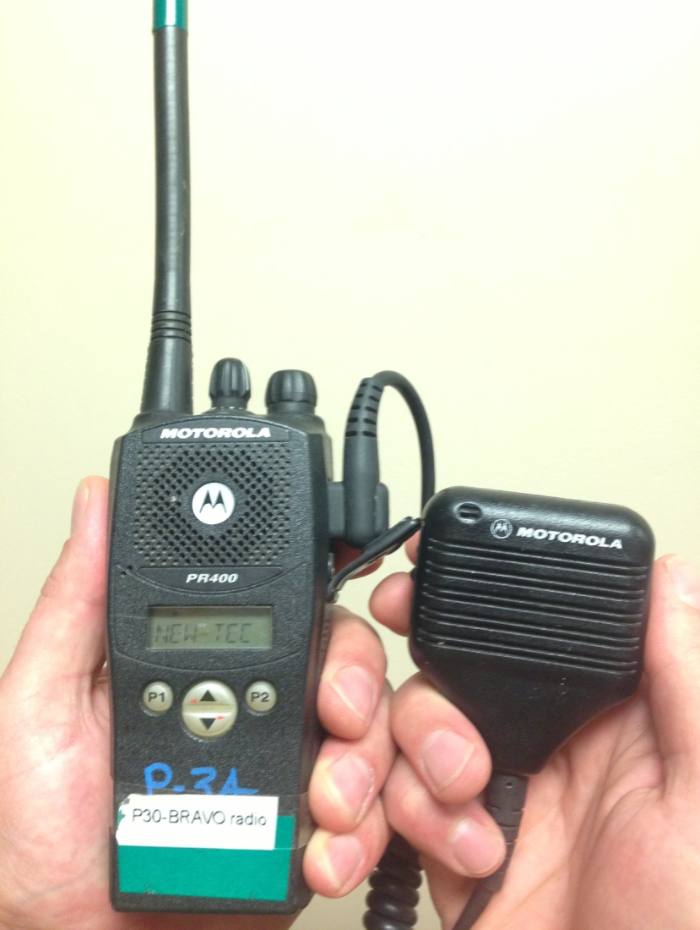
New Tecumseth Fire Rescue Radio Setup
On-board Portable Radios can consist of a radio and a remote microphone/speaker.
PR400’s have a display window which show the radio’s currently set operating channel.

Slide 27
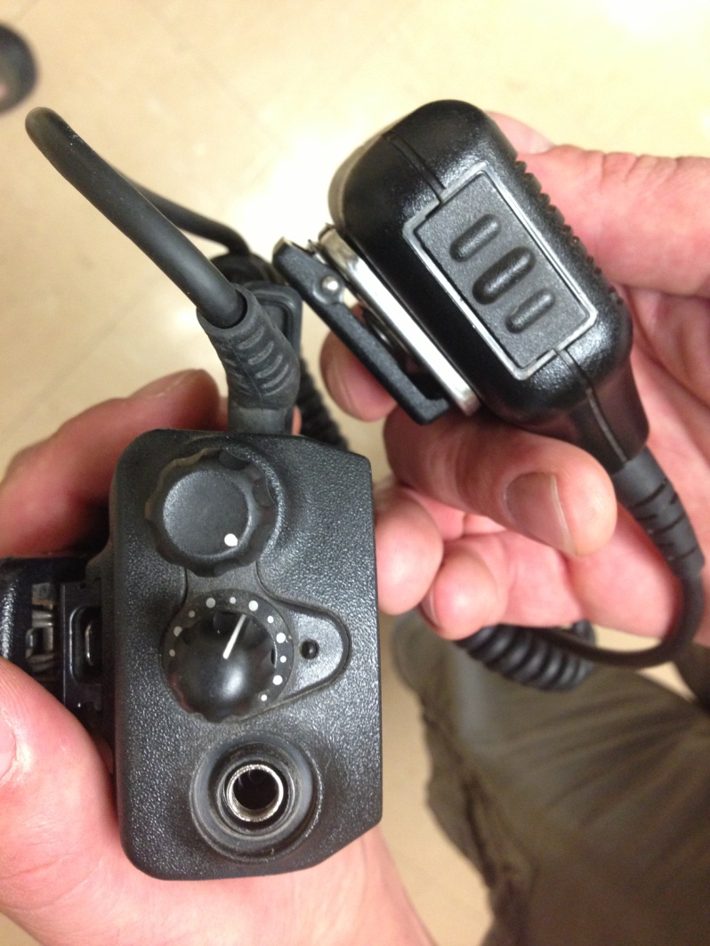
New Tecumseth Fire Rescue Radio Setup
PR400 Portable Radio controls include channel selection dial and a volume control dial which when dialed to the clockwise is the On and volume setting. Turn volume dial counter clockwise to turn portable radio off.
Volume Dial Channel Selection Dial

Slide 28
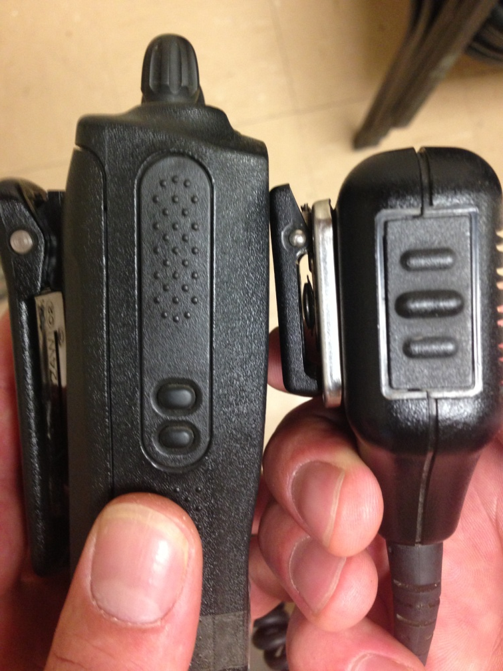
New Tecumseth Fire Rescue Radio Setup
PR400 Portable Radio transmit controls are located on the left side of the portable radio body and on the left side of the remote microphone. These are referred to as Push-To-Talk or “PTT”s
Remote Mic PTT Radio PTT

Slide 29
New Tecumseth Fire Rescue Radio Setup
Portable Radio Use Tips
To Transmit a message, hold the PTT down, wait 3 seconds, and then begin your message.
Once message is complete, release the PTT.
Speak clearly. Plan your message before you press the PTT. Use clear-speech and keep messages short. Portables are not for story-telling.

Slide 30
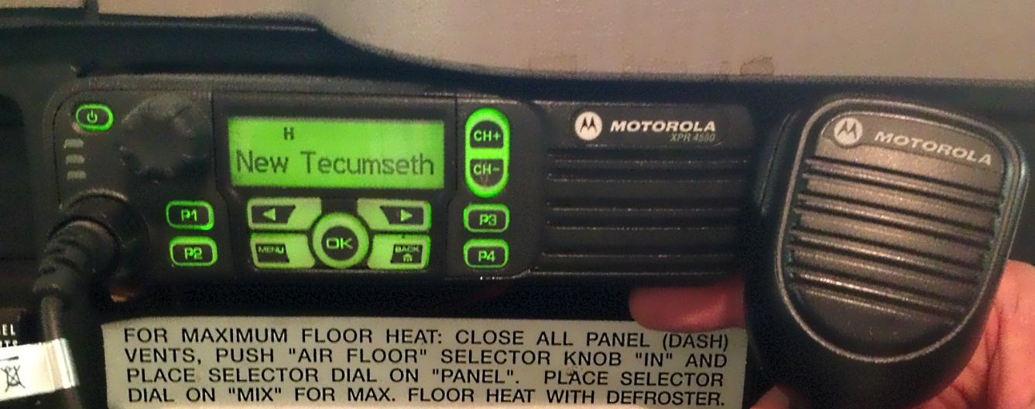
New Tecumseth Fire Rescue Radio Setup
Mobile Radios (in-truck)
Mobile radio have similar controls to portable radios. Mobile radios have advantages over portable radios such as:
Powered by truck
5 times more transmission power (45 watts vs. 5 watts) - Better Antennas

Slide 31
Learning Objective 4
Explain radio limitations that may impact internal communications.

Slide 32
There are several radio limitations that can impact internal communications.
Click for next slide

Slide 33
REVIEW QUESTION
What radio limitations can impact internal communications?

Slide 34
Learning Objective 5
Describe radio procedures used for internal communications.

Slide 35
Always follow local protocols when sending a message, these are part of the official incident record.
Identify yourself
Acknowledge message
Wait a second or two for signal

Slide 36
WARNING
DO NOT REMOVE YOUR FACEPIECE TO TALK INTO THE MIC.

Slide 37
REVIEW QUESTION
What radio procedures must be followed for internal communications?

Slide 38
Documenting a Call using a Run Sheet

Slide 39
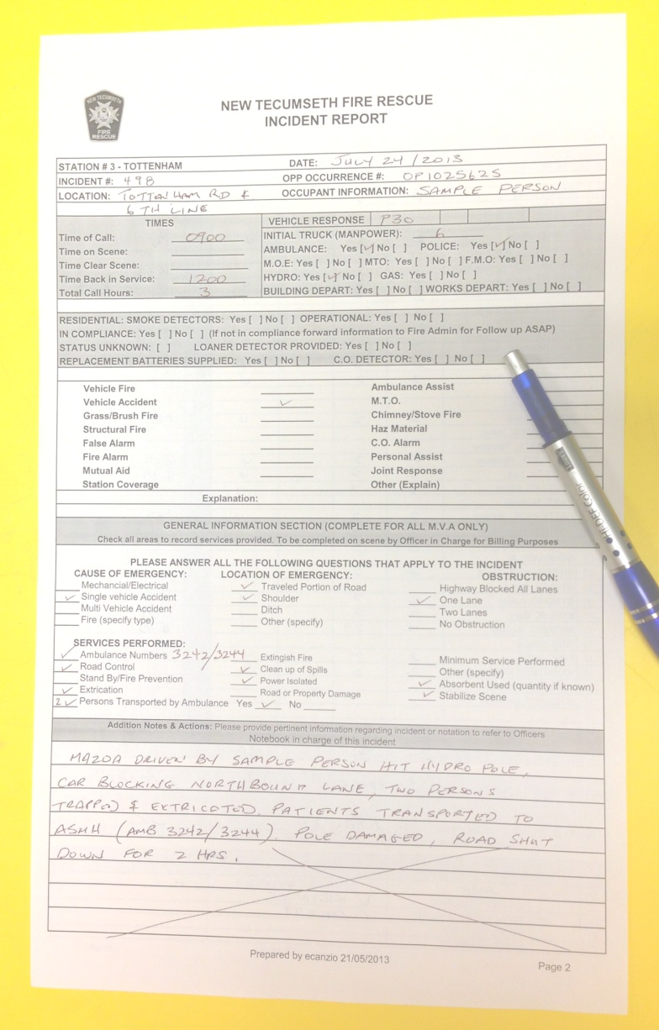
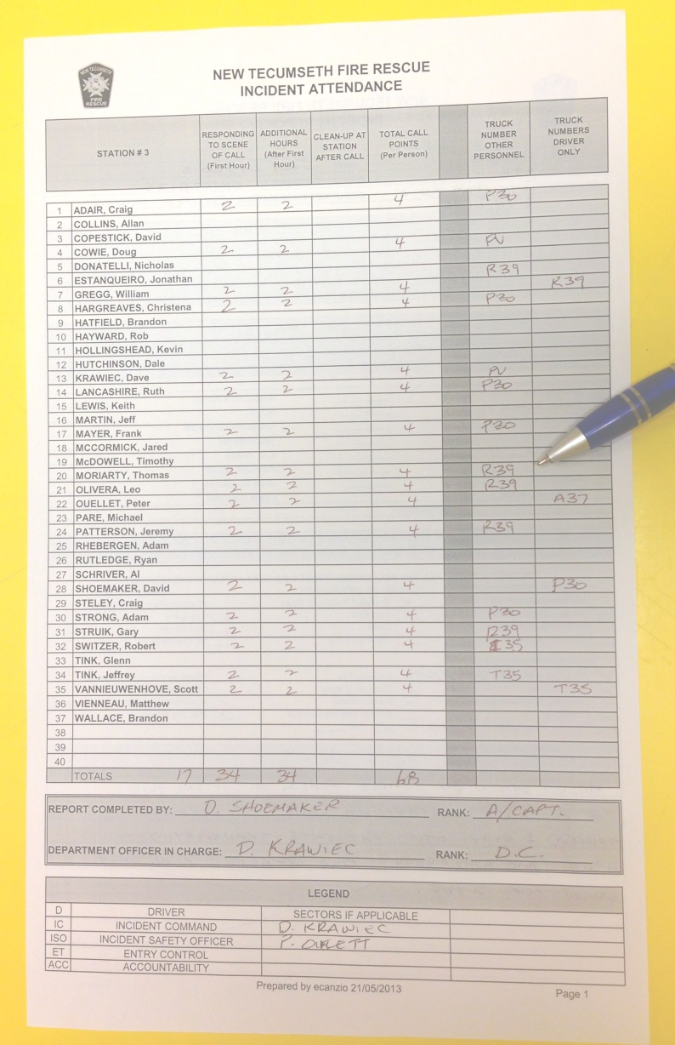
Documenting a Call using a Run Sheet

Slide 40
Summary
Fire department communications are a critical factor in the successful outcome of any incident.
There is a direct connection between fireground communications and fireground safety: The better the communications, the safer the incident.

Slide 41
Learning Objective 6
Handle emergency and nonemergency calls.
This objective is measured in Skill Sheet 3-I-1.

Slide 42
Learning Objective 7
Use a portable radio for routine and emergency traffic.
This objective is measured in Skill Sheet 3-I-2.

